Slide 1
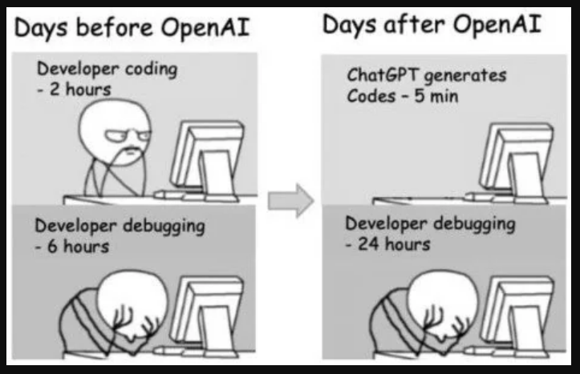

Slide 2
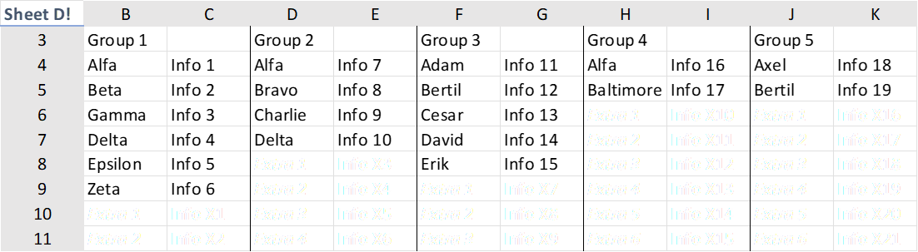
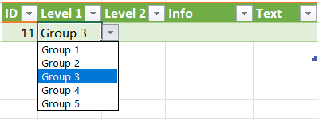
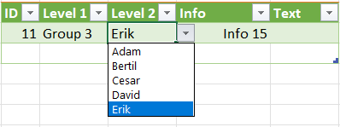
What the Client asked for
Set up
Choose a group
Next level allows items from that group
Show the items info text

Slide 3
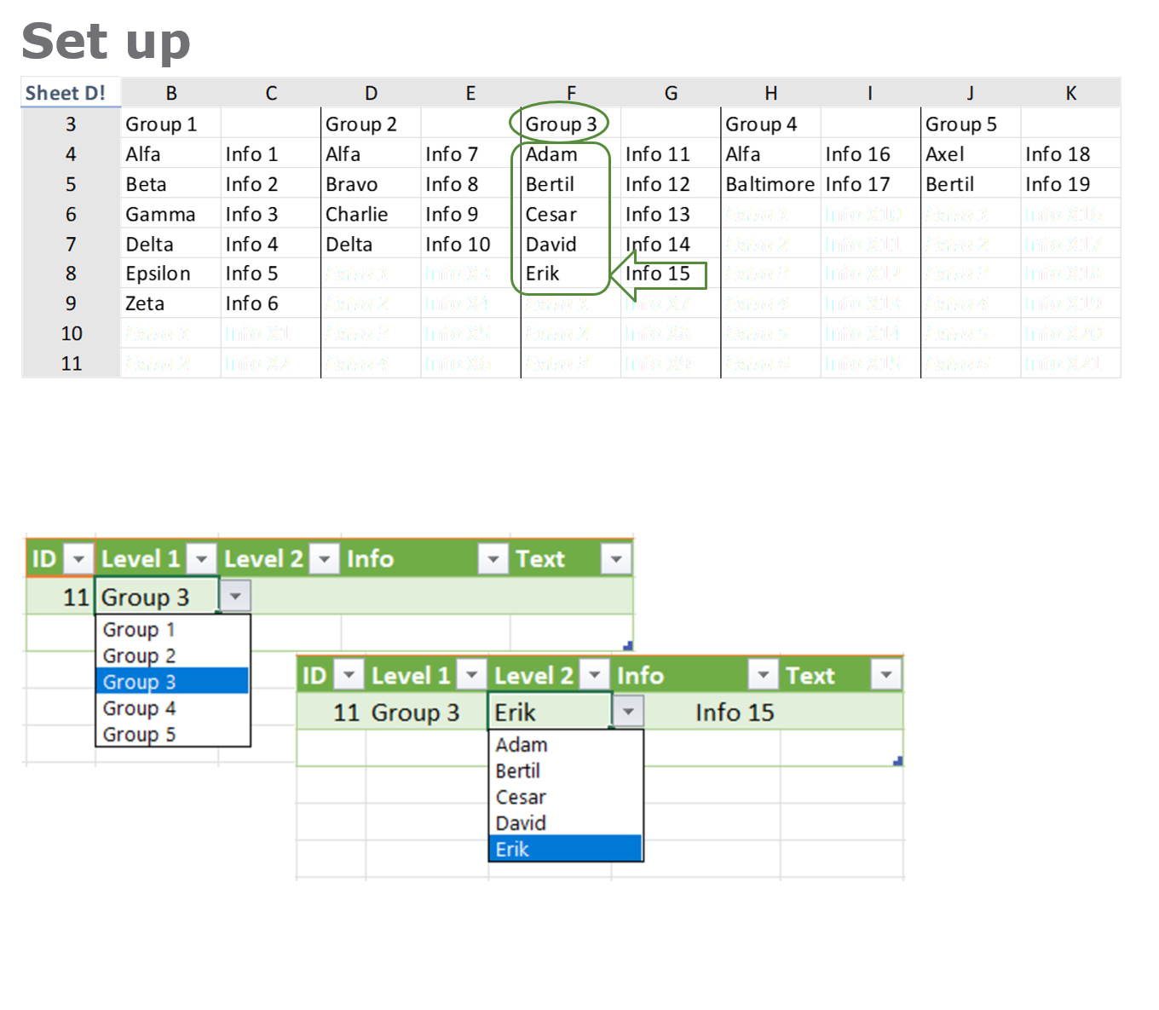
What the Client asked for
Hierachic Data Validation
Set up
Level 1 consists of five groups
Each group relates to a set of items
Each item has a descriptive text
The items in each group are to be editable and possible to extend.

Slide 4
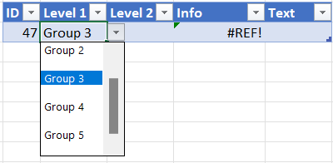
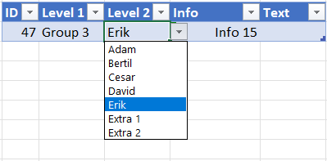
What the internet supplied
Target
Set up
Choose a group;
Next level allows items from that group
Result
Empty selectable groups
Extra selectable items.

Slide 5
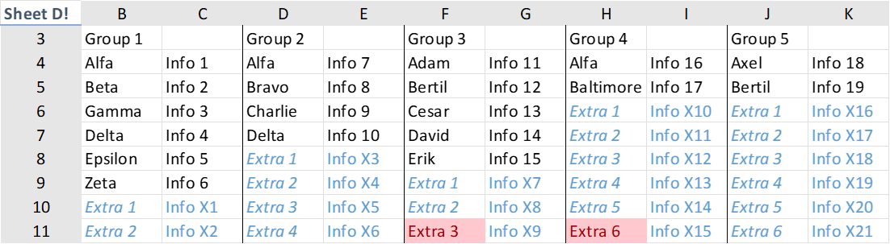
Adjustments
Bugs
Set up
Group 3 and 4 do not deliver all items
Reference error not plausible when item not selected.
Result
Empty selectable groups
Extra selectable items.

Slide 6
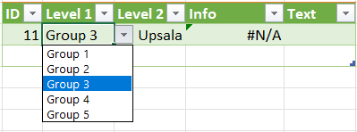
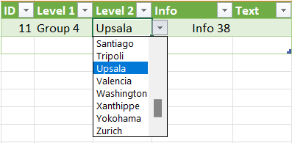
DIRFT (Do it right first time)
User Experience
Set up
Error when changing group after selecting item → impossible combination
”Pyamas” Table
editable
easily sortable
easily expandable

Slide 7
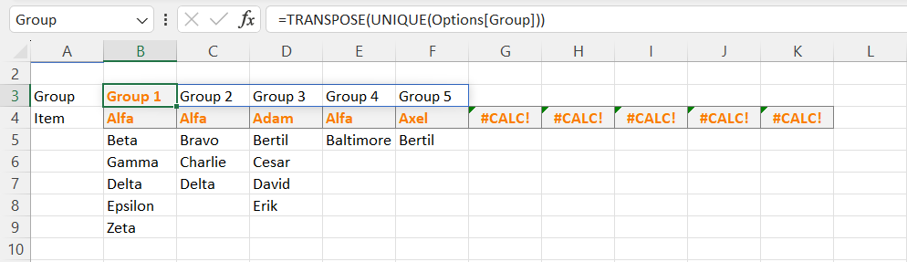
Formulas
No of Chars – not really a problem but more to read
No of Function Calls – each call is a possible source for bugs. Fewer is better and more stable
No of Unique Functions – when one other function can replace multiple calls, it may be worth the while to learn and use it
No of Hard Coded Strings – avoid them since when the data/string changes, formulas has to be updated. Unless the string is a never changing empty string
No of Hard Classic References – well, it’s simply a classic way of writing formulas excluding possibilities like sorting. It is time-consuming when fixing bugs or maintaining such as introducing changes in the organization, or just further clean development.
Level 1 – Data Validation
=D!$B$3:$K$3
Level 2 – Data Validation
=IF(C8="Group_1";D!$B$5:$B$12;IF(C8="Group_2";D!$D$5:$D$13;IF(C8="Group_3";D!$F$5:$F$11;IF(C8="Group_4";D!$H$5:$H$10;IF(C8="Group_5";D!$J$5:$J$12)))))
Info – Calculation
=IF(D8=D!$B$5;D!$C$5;IF(D8=D!$B$6;D!$C$6;IF(D8=D!$B$7;D!$C$7;IF(D8=D!$B$8;D!$C$8;IF(D8=D!$B$9;D!$C$9;IF(D8=D!$B$10;D!$C$10;IF(D8=D!$B$11;D!$C$11;IF(D8=D!$B$12;D!$C$12;IF(D8=D!$D$5;D!$E$5;IF(D8=D!$D$6;D!$E$6;IF(D8=D!$D$7;D!$E$7;IF(D8=D!$D$8;D!$E$8;IF(D8=D!$D$9;D!$E$9;IF(D8=D!$D$10;D!$E$10;IF(D8=D!$D$11;D!$E$11;IF(D8=D!$D$12;D!$E$12;IF(D8=D!$D$13;D!$E$13;IF(D8=D!$F$5;D!$G$5;IF(D8=D!$F$6;D!$G$6;IF(D8=D!$F$7;D!$G$7;IF(D8=D!$F$8;D!$G$8;IF(D8=D!$F$9;D!$G$9;IF(D8=D!$F$10;D!$G$10;IF(D8=D!$F$11;D!$G$11;IF(D8=D!$H$5;D!$I$5;IF(D8=D!$H$6;D!$I$6;IF(D8=D!$H$7;D!$I$7;IF(D8=D!$H$8;D!$I$8;IF(D8=D!$H$9;D!$I$9;IF(D8=D!$H$10;D!$I$10;IF(D8=D!$J$5;D!$K$5;IF(D8=D!$J$6;D!$K$6;IF(D8=D!$J$7;D!$K$7;IF(D8=D!$J$8;D!$K$8;IF(D8=D!$J$9;D!$K$9;IF(D8=D!$J$10;D!$K$10;IF(D8=D!$J$11;D!$K$11;IF(D8=D!$J$12;D!$K$12;""))))))))))))))))))))))))))))))))))))))
Level 1 – Data Validation
=Group#
Defined name Group=TRANSPOSE(UNIQUE(Options[Group]))
Direct cell references in Data Validation formulas tend to be time consuming to maintain and debug. Cells may during further development or bug fixing be reorganized and moved
Level 2 – Data Validation
=item_opt
item_opt=INDEX(Group#:Item;2;XMATCH(Work!C8;Group#))#
Hard coded strings need to be manually updated – especially in data validation formulas where they cannot be reached by find and replace
Info – Calculation
=IF($D8="";"";INDEX(INDEX(Group_i#:Info;2; XMATCH($C8;Group#))#;XMATCH($D8;item_opt)))
Long, nestled and repetitive formulas are harder to read and adjust when it comes to debugging and further development
 | Blue | Green
No of Chars | 989 | 231
No of Function Calls | 43 | 11
No of Unique Functions | 1 | 5
No of Hard Coded Strings | 6 | 2 (0)
No of Hard Classic References | 88 | 2
Notes:
No of
- Chars – not really a problem but more to read
- Function Calls – each call is a possible source for bugs. Fewer is better and more stable
- Unique Functions – when one other function can replace multiple calls, it may be worth the while to learn and use it
- Hard Coded Strings – avoid them since when the data/string changes, formulas has to be updated. Unless the string is a never changing empty string
- Hard Classic References – well, it’s simply a classic way of writing formulas excluding possibilities like sorting. It is time-consuming when fixing bugs or maintaining such as introducing changes in the organization, or just further clean development.
-/-
Info alternative
=LET(level1value;[@[Level 1]]; level2value;[@[Level 2]]; level1match;XMATCH(level1value;Group#); info_items;INDEX(Group_i#:Info; 2; level1match)#; level2match;XMATCH(level2value;item_opt); output;IF(level2value="";"";INDEX(info_items;level2match)); output )

Slide 8
"How to use ChatGPT to write Excel formulas" https://www.zdnet.com/home-and-office/work-life/how-to-use-chatgpt-to-write-excel-formulas/
Med AI-teknik kommer folk som egentligen inte behärskar ett område kunna komma en bit på väg
Men egentligen vet de ju fortfarande inte varken hur eller varför (även om AI motiverar och förklarar en del)
Risken att det är fel ökar (och hitta fel tar ofta längre tid än att göra rätt från början)
liksom risken att de inte kommer vidare
Men visst kan AI bistå med en grund och lösa delar av större problem bara genom sin enorma faktabas.
Och visst kommer Microsoft lägga till ChatGPT-baserade assistenter inne i Office-programmen…
…men förhoppningsvis utan "animerade gem"...!
Notes:
Med AI-teknik kommer folk som egentligen inte behärskar ett område kunna komma en bit på väg, men egentligen vet de ju fortfarande inte varken hur eller varför (även om AI motiverar och förklarar en del) så risken att det är fel ökar (och hitta fel tar ofta längre tid än att göra rätt från början) liksom risken att de inte kommer vidare - men visst kan AI bistå med en grund och lösa delar av större problem bara genom sin enorma faktabas. Och visst kommer Microsoft lägga till ChatGPT-baserade assistenter inne i Office-programmen, men förhoppningsvis utan "animerade gem"...!

Slide 9
FAQs
Is there a way to use AI for formulas within Excel?
Ideally, you could generate formulas within Microsoft Excel as easily as with ChatGPT by having an AI tool already built into the program.
That's not the case at this time, but Microsoft is rolling out a set of AI tools for many of its products, including the Microsoft 365 suite of programs named Copilot.
Why is the formula from ChatGPT not working?
ChatGPT might have misunderstood your prompt if it gives you a formula that isn't working in Excel or Sheets.
Go through the formula to see where the error could be on ChatGPT's end and see how you can reword your prompt to get the correct answer.
Notes:
Though Microsoft Copilot isn't widely available yet, one can hope the new features include a GPT-4-integrated Microsoft Excel.

Slide 10

IOCCC – the five assumptions for secure personal AI chatbot use
1) Input disclosure: “- Information I enter into an AI chatbot is thereby disclosed and will be made available to others.”
2) Output traceback: “- Answers I receive from an AI chatbot can later be traced back to that chatbot.”
3) Conversation logging: “- Conversations that I have with an AI chatbot are stored in my name and affiliation for future use.”
4) Copyright infringement: “- I may be infringing on legally protected rights if I make the chatbot’s answer available to others, since answers are generated based on copyrighted sources.”
5) Chatbot hallucination: “- AI chatbots are not telling the truth, they are often incomplete, biased and hallucinate.”
Make no mistake – the AI chatbot scene is like “the wild wild west” right now! In the meantime, use these five assumptions are your starting point when chatting with the bots. Take care out there cowboys and cowgirls! Fredrik Blix, Director at Knowit Secure / Associate Professor (Universitetslektor)
https://www.linkedin.com/feed/?msgControlName=view_message_button&msgConversationId=2-NjU0ZjA1YWQtYmY4OS00N2E5LWI3NDAtYjc1MGFlYzhlMTg5XzAxMw%3D%3D&msgOverlay=true&trk=false

Slide 11


Slide 12
Värt att veta
# - Ankare i ett område som räknar med spill
LET – skippa mellanberäkningar och gör den sammanhållen i en (1) cell
LAMBDA – gör om LET till en helt ny funktion, eg endDown för att markera okänt stort område
MAKEARRAY – låt en cell spilla lambda-beräkningar
@ – encellig skärning
[mellanslag] – flercellig skärning
INDEX(;0;0) – flercellig adressering
SEQUENCE – nödvändigt i kombination med statiska matriser {}
CHOOSE och SWITCH
IFS
SORT, UNIQUE, VSTACK
HSTACK och :
TAKE och DROP
VLOOKUP → XLOOKUP → FILTER
(MATCH → XMATCH)
SUM – inkluderar numera naturligt SUMPRODUCT. Ersätter gamla {ctrl+shift+enter}
SUMIFS – inte heller ny men numera flitigt använd
--() – liknande N men fungerar ;-) och ger FILTER möjlighet till flera villkor (jfr IFS)
//Misc och oldish
IFERROR
SEARCH vs FIND
ROUND
OFFSET
TRANSPOSE
SUBSTITUTE, TEXTAFTER, MID, RIGHT
very hidden…

Slide 13

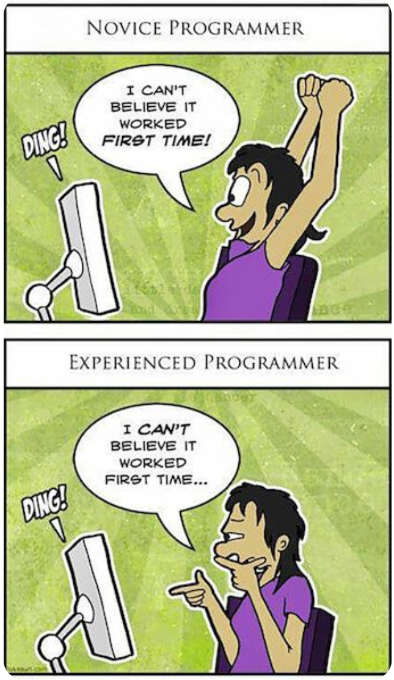

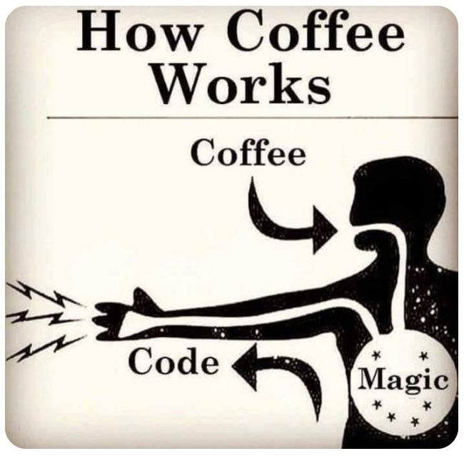

Slide 14
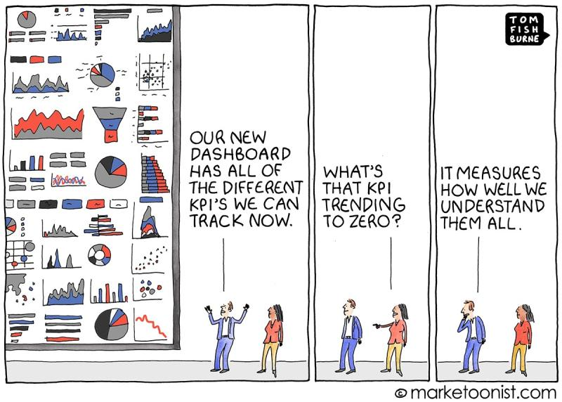

Slide 15
Många rapporter som ska iväg?
Press F5 to start slide show
Ligger siffrorna på hög?
Har du… utvecklingsbara hjälpmedel?
Med nya möjligheter kan du spara tid och pengar!
Och få mer gjort!
Med hjälp att balansera bördan…
…så går det än fortare att få iväg rapporterna!
Vi kan hjälpa dig hela vägen, från datafångst till distribuerad information
Du kan räkna med oss!
excel.control.se
+ 46 70 500 0000
+ 46 70 500 0000
204
204
5250 69
5250 69
0
0
4711
4711
44 87 3421
44 87 3421
5583 3010
NEW EXCEL FUNCTIONALITY
APPLIED EXCEL COMPETENCE
NEW EXCEL FUNCTIONALITY
APPLIED EXCEL COMPETENCE
Classic Excel Models
#
@
#
@
Notes:
”Spara pengar” avser inte minst att ”spara dollar” då behovet av de besvärliga dollartecknen försvinner.
A Circle is a Square that has figured out its angles.
(Dartwill Aquila)

Slide 16




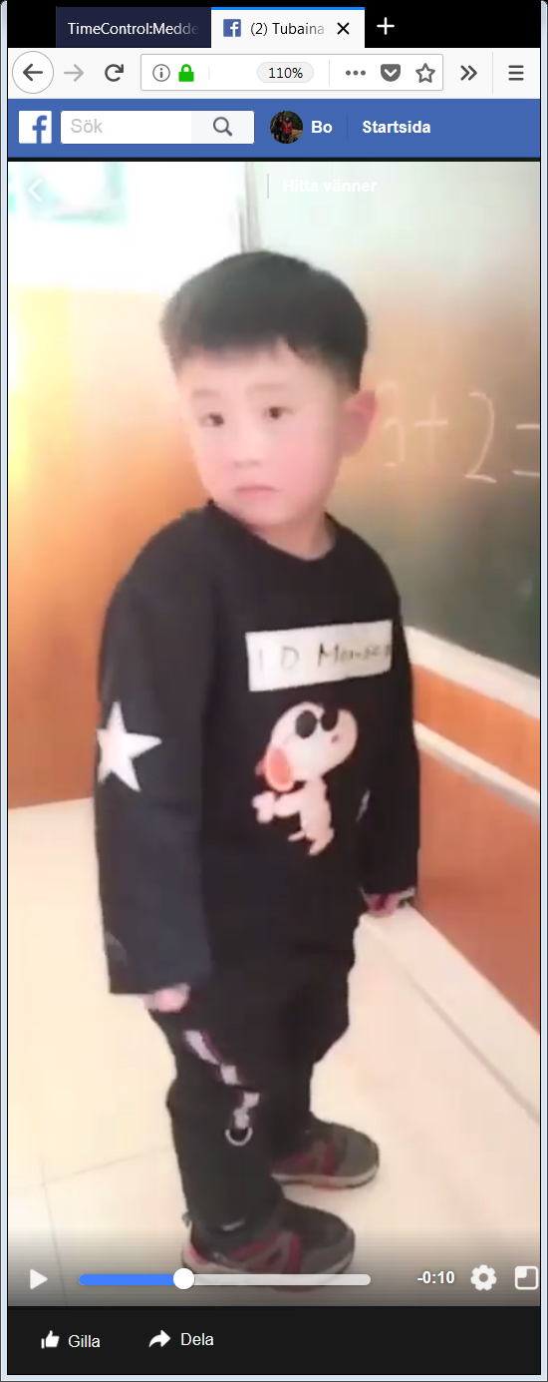

3 + 2 =

Slide 17
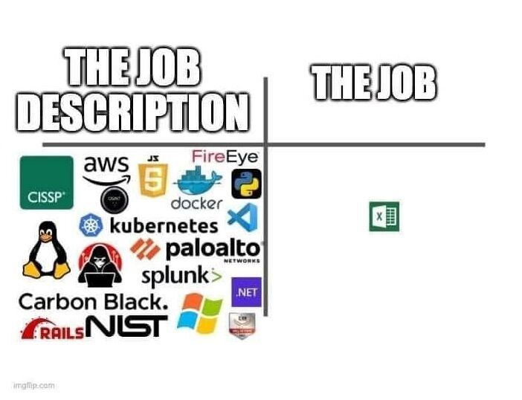

Slide 18


Slide 19
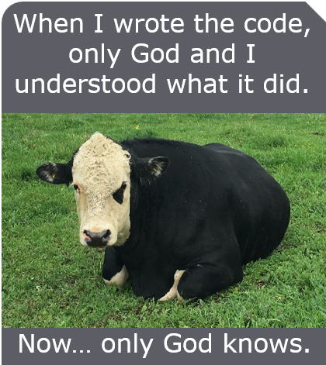

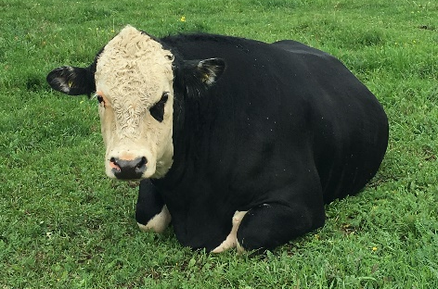
When I wrote the code, only God and I understood what it did.
Now… only God knows.

