Slide 1
SAP Data Validator
or, how to validate two tables
Press F5 to start slide show
Notes:
Bo Sinander, +46 70 550 0000

Slide 2
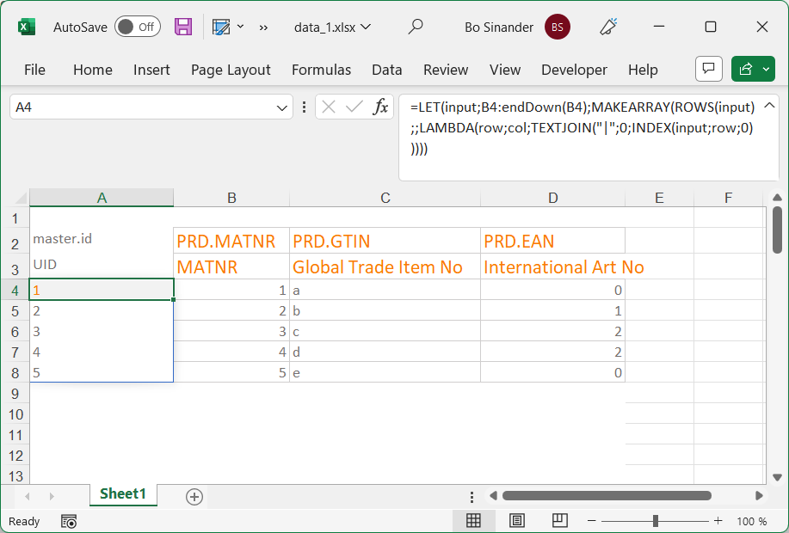
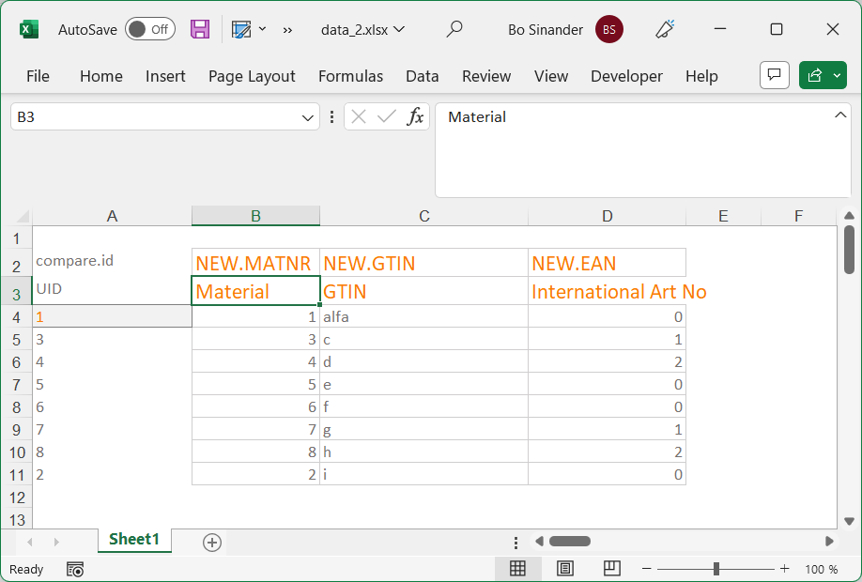
Open two files with tables to compare
They are expected to have the same columns, in the same order whereof the first one holds a unique ID that will be looked up between the tables. Column names and row order may differ.

Slide 3
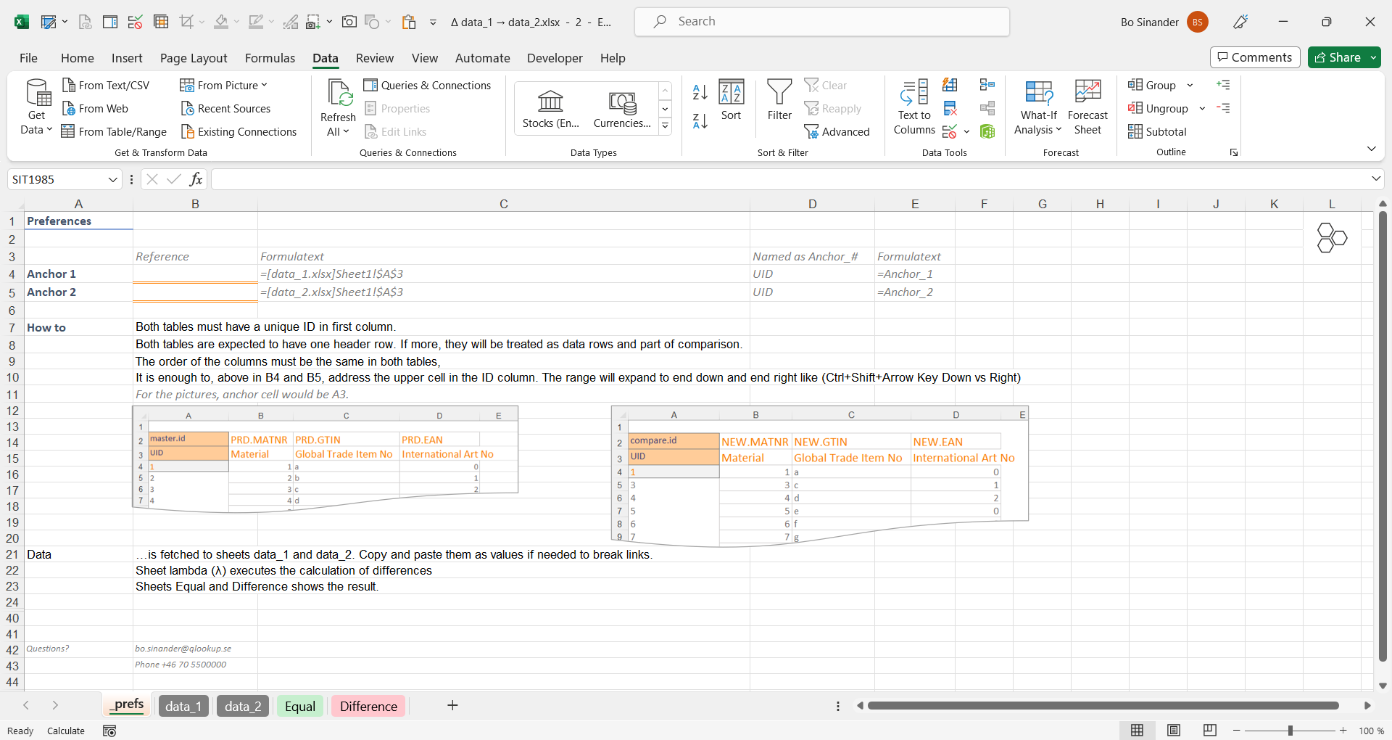
Set the anchors of the two tables
Sheet _prefs, select cell B4
The formula shall be a pointer to the first tables upper left cell.
Type =
Switch to table 1 file
Click on upper left cell* and press Enter
Redo with B5 and file/table 2
in this example, cell A3 – the title row closest to the data

Slide 4
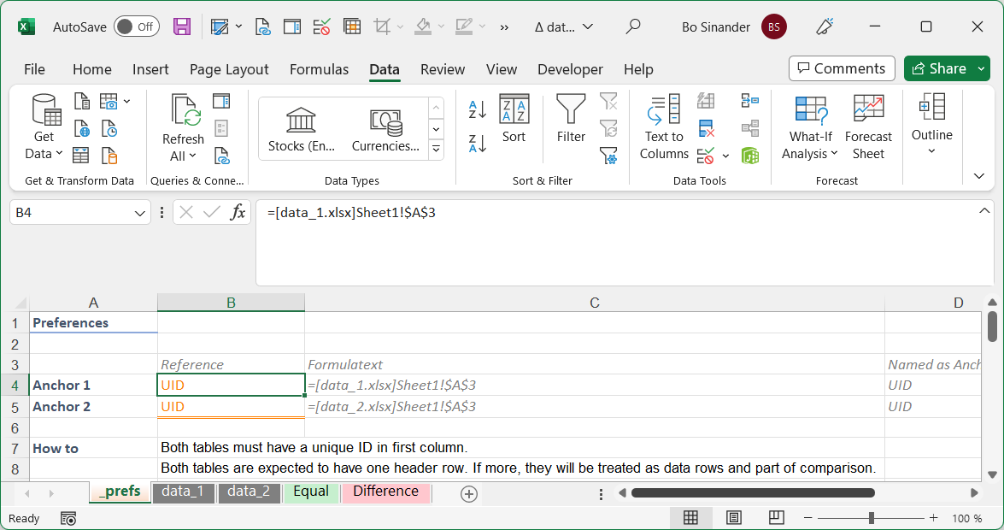
Set the anchors of the two tables
Cells C4 and C5 shows the tables anchors. Since the files are open, their full paths are omitted.

Slide 5
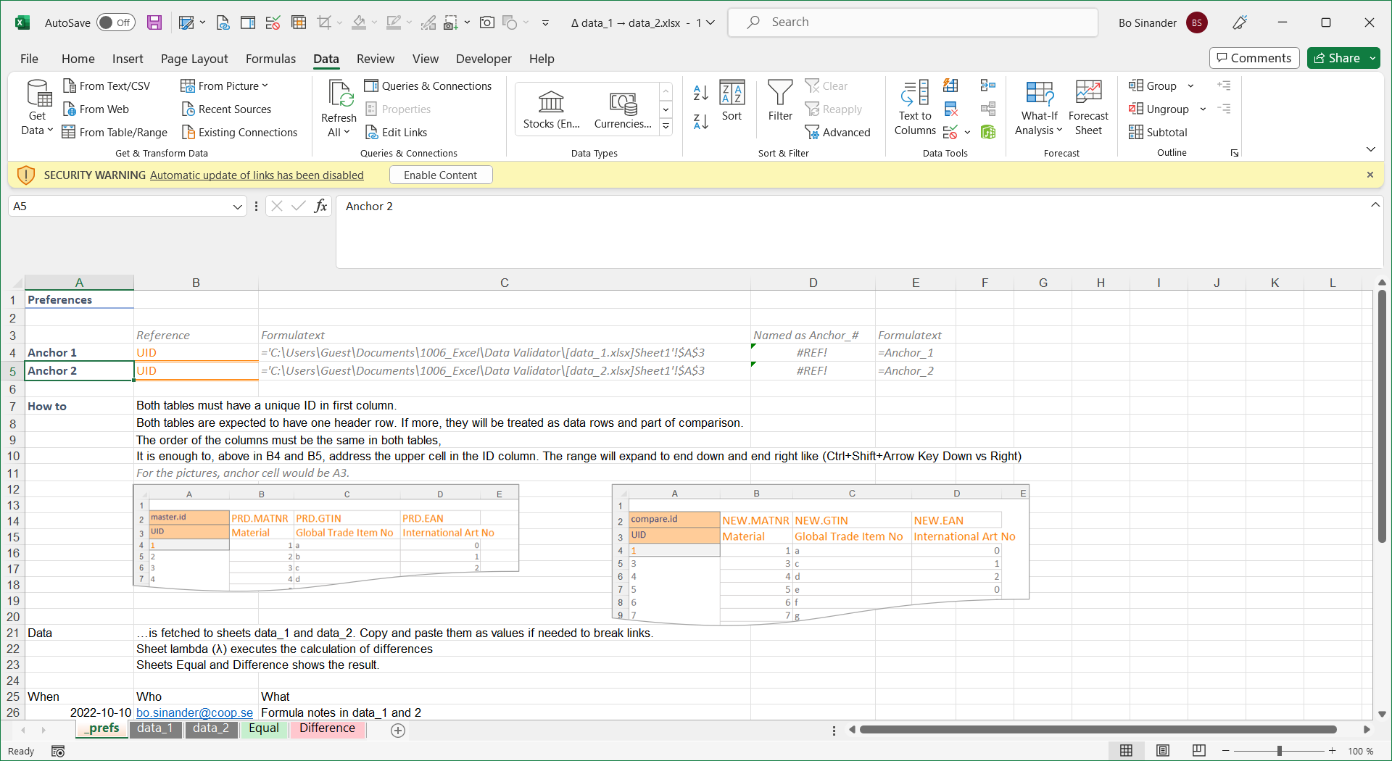
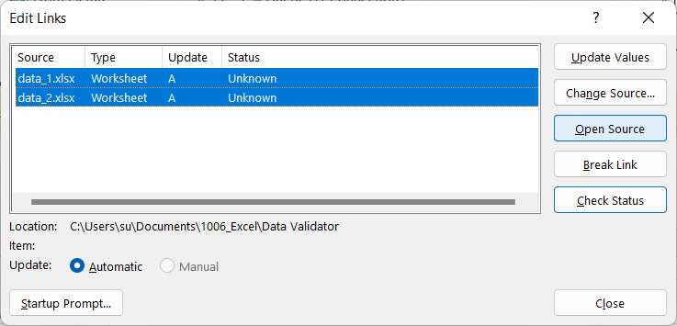
File open with anchors already set?
The yellow warning banner indicates links to other files. Click [Enable Content]
Data: Edit Links Select both files* and click [Open Source] to open the linked files
Shift+Click the files

Slide 6
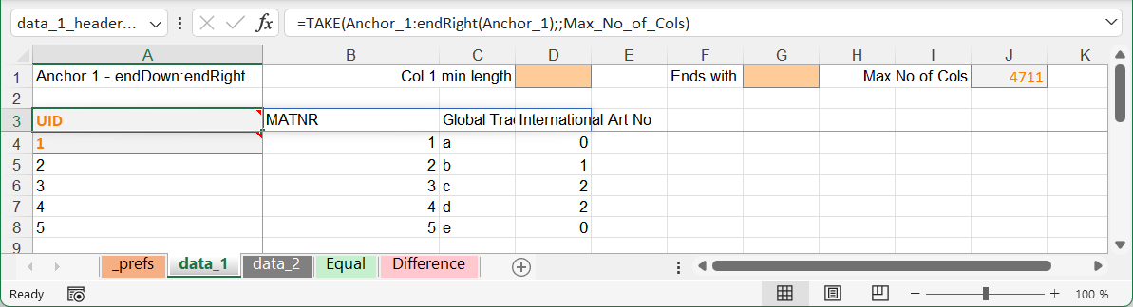
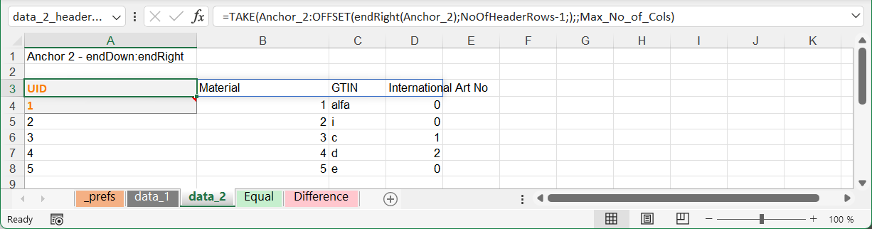
Help calculations…
Sheet data_1 show data from table one. It can be filtered by length, to end with special character (set here) and may be delimited to show only a few first columns (set later).
data_2 shows looked up rows from the second table.

Slide 7
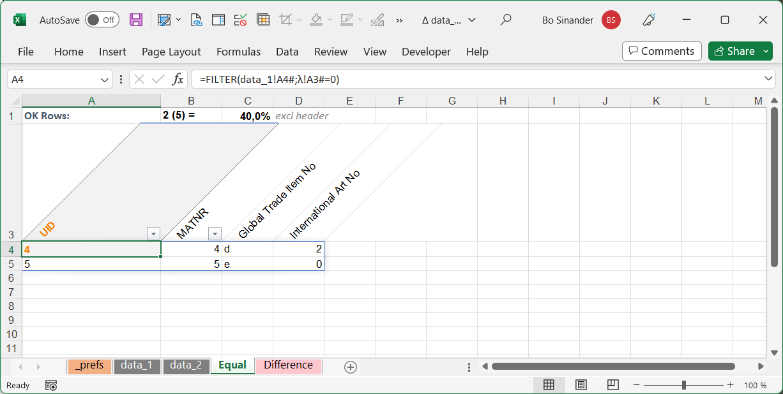
Rows that are equal
The unique ID in table one looked up in table two, and rows that are equal listed on sheet Equal.

Slide 8
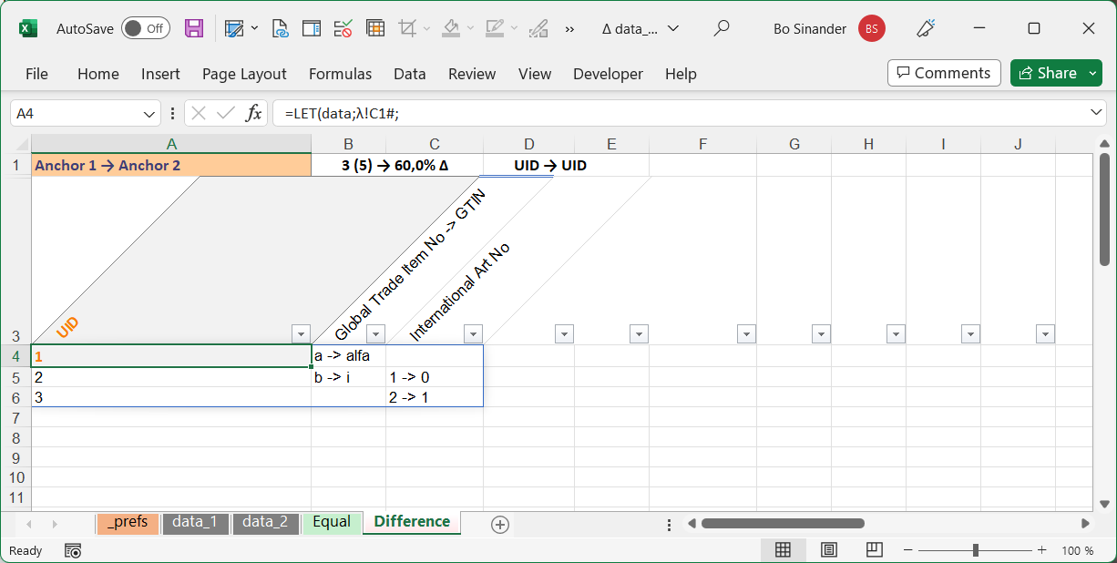
Rows that differs
The sheet Difference shows rows from table one where the data in table two is different.

Slide 9
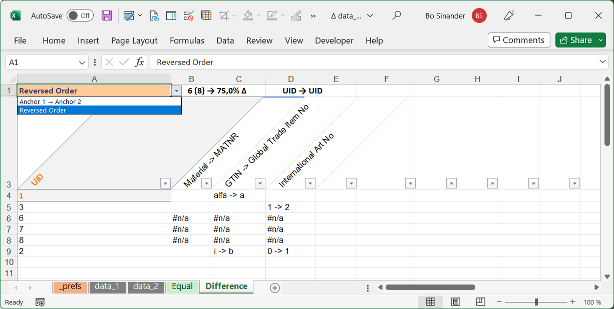
Rows that differs
Cell A1 holds a possibility to switch table one to two and thus see the differences the other way.

Slide 10
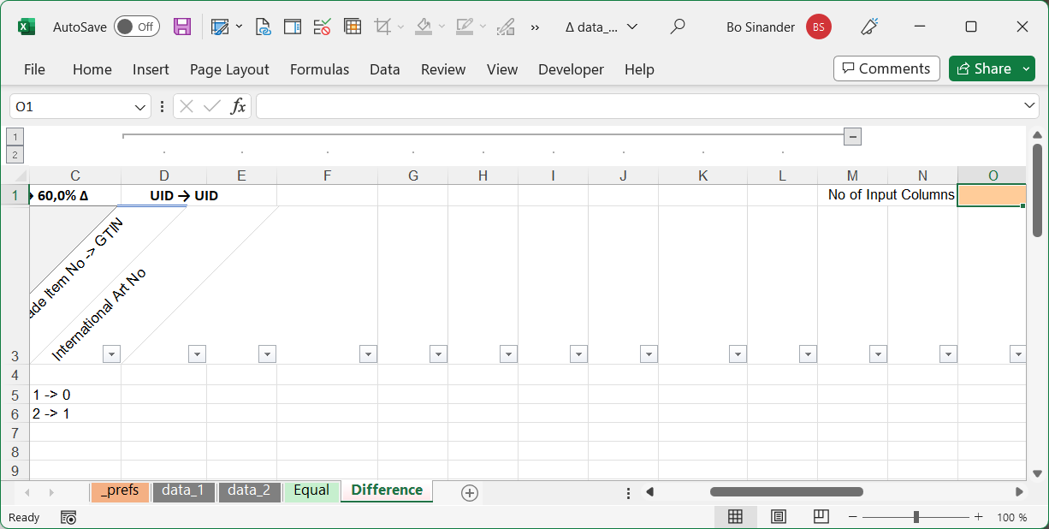
Rows that differs
Cell O1 is the earlier mentioned possibility to delimit the number of validated columns.
Ctrl+8 toggles visibility of outlined columns*
Menu Data, Group Outline

Slide 11
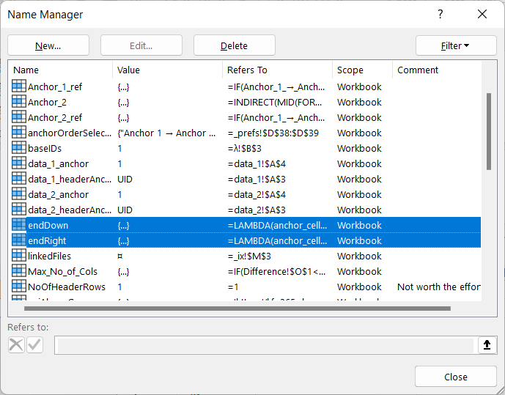
Beyond Basix – Excel 365 is needed
As of 2022, you must use Excel 365 since used functionality is not available with eternity licenses.
Two LAMBDA functions are used to fetch all rows and columns directly from worksheets.
eg a formula in cell C1 like =A1:endDown(A1) will fetch data like from A1 selecting cells using Ctrl+Shift+Arrow Key Down
Copying the example cell C1 to another workbook brings the LAMBDA function to the other file!

Slide 12
A lot of options available!
Notes:
Bo Sinander, +46 70 550 0000

